Slide 1
Multimedia Systems Lecture – 9
By
Dr. Priyambada Subudhi
Assistant Professor
IIIT Sri City

Slide 2
Higher Bit-Depth Images
More information about the scene being imaged can be gained by using more accuracy for pixel depth (64 bits, say); or by using special cameras that view more than just three colors (i.e., RGB).
Here the idea might be to use invisible light (e.g., infrared, ultraviolet) for security cameras, say, or to produce medical images of skin that can utilize the additional colors to better diagnose skin ailments such as carcinoma.
Another reason for using high bit-depth is in satellite imaging, where extra information can give indication of types of crop growth, etc.
Such images are called multispectral (more than three colors) or hyperspectral (a great many image planes, say 224 colors for satellite imaging).

Slide 3
Popular Image File Formats
8-bit GIF: one of the most important formats because of its historical connection to the WWW and HTML markup language as the first image type recognized by net browsers.
JPEG: currently the most important common file format.
PNG: most popular lossless image format.
TIFF: flexible file format due to the addition of tags.
EXIF: allows the addition of image metadata.
PS and PDF: vector based language, popular in publishing and academia

Slide 4
GIF (Graphic Interchange Format)
GIF standard: We examine GIF standard because it is so simple! yet contains many common elements.
Limited to 8-bit (256) color images only, which, while producing acceptable color images, is best suited for images with few distinctive colors (e.g., graphics or drawing).
GIF standard supports interlacing — successive display of pixels in widely-spaced rows by a 4-pass display process.
GIF actually comes in two flavors:
GIF87a: The original specification.
GIF89a: The later version. Supports simple animation via a Graphics Control Extension block in the data, provides simple control over delay time, a transparency index, etc.

Slide 5
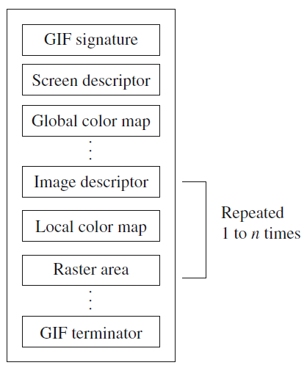
GIF87
Since many such formats bear a resemblance to it but have grown a good deal more complex than this “simple” standard, it is worth examining the file format for GIF87 in more detail.
For the standard specification, the general file format is as shown in the figure.

Slide 6
The Signature is six bytes: GIF87a; the Screen Descriptor is a seven-byte set of flags.
A GIF87 file can contain more than one image definition, usually to fit on several different parts of the screen.
Therefore each image can contain its own color lookup table, a Local Color Map, for mapping 8 bits into 24-bit RGB values.

Slide 7
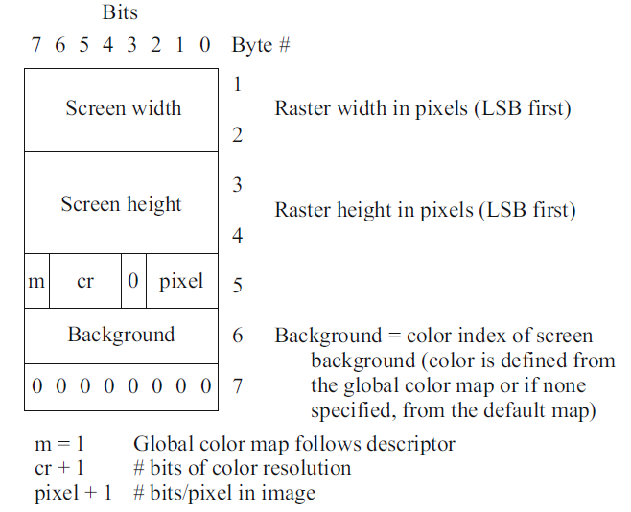
The Screen Descriptor comprises a set of attributes that belong to every image in the file.

Slide 8
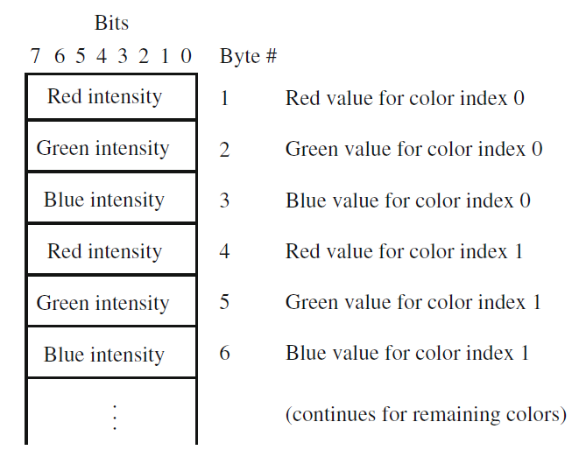
GIF Color Map

Slide 9
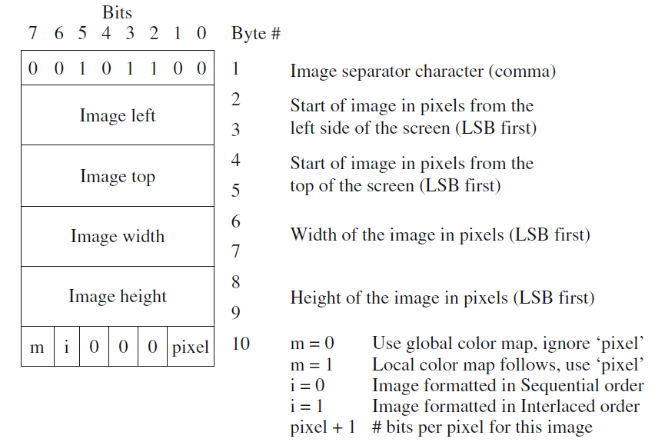
GIF image descriptor

Slide 10
Raster Area:
The format of the actual image is defined as the series of pixel color index values that make up the image.
The pixels are stored left to right sequentially for an image row.
By default each image row is written sequentially, top to bottom.
In the case that the Interlace or ‘i' bit is set in byte 10 of the Image Descriptor then the row order of the image display follows a four-pass process in which the image is filled in by widely spaced rows.
The first pass writes every 8th row, starting with the top row of the image window. The second pass writes every 8th row starting at the fifth row from the top. The third pass writes every 4th row starting at the third row from the top. The fourth pass completes the image, writing every other row, starting at the second row from the top.

Slide 11
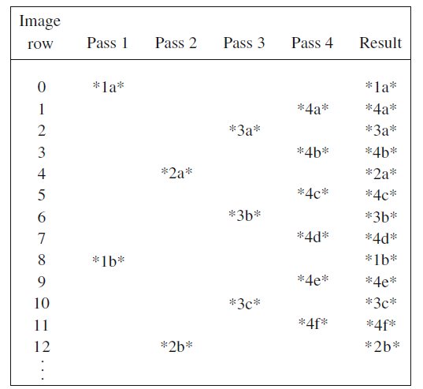
GIF four-pass interlace display row order

Slide 12
GIF Terminator
In order to provide a synchronization for the termination of a GIF image file, a GIF decoder will process the end of GIF mode when the character 0x3B hex or ';' is found after an image has been processed.

